Slide 1


Challenge: MEASURING THE VALUE OF EARTH OBSERVATIONS
Project name: Observation development in nature (ODIN)
Objective: Describe how Earth observations form a concrete solution that leads to improved outcomes for society.
Ukraine
Dnipro
2021
-1-
SV2
SV2

Slide 2
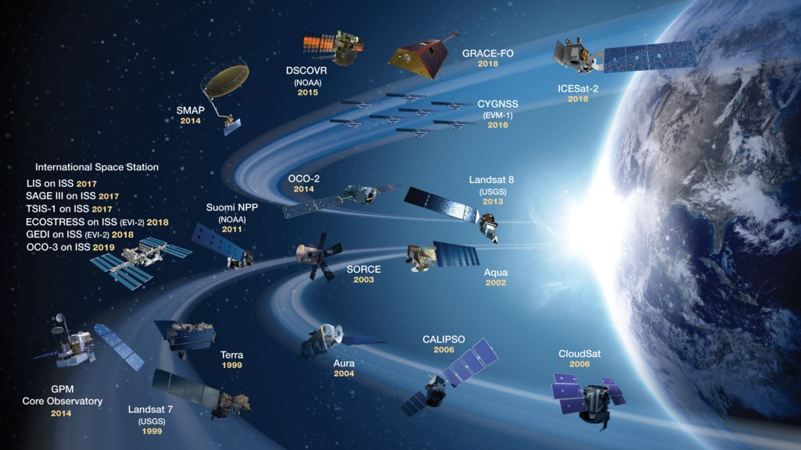
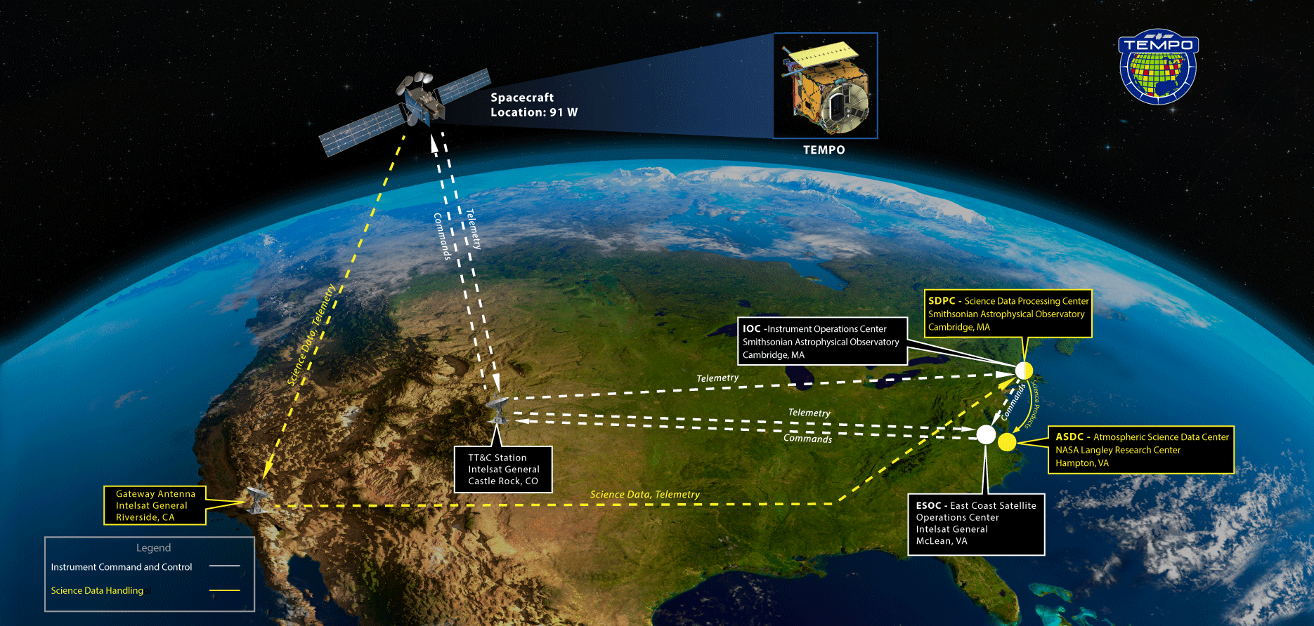
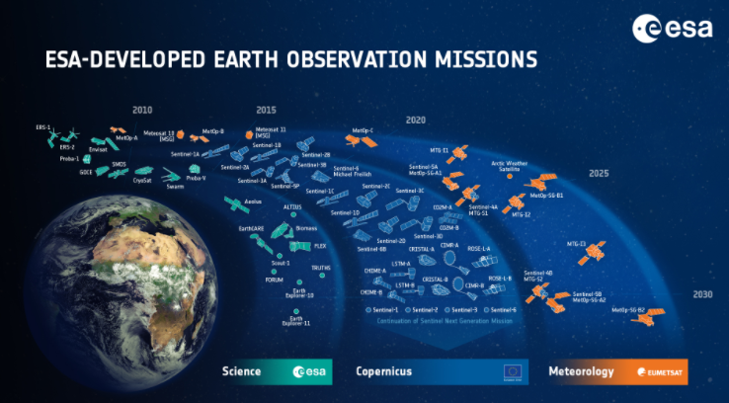
Over the last two decades, the proliferation of remote sensing satellites combined with improved resolution has yielded vast amounts of new data for environmental monitoring and application. However, the most significant achievements go beyond space resources. They include a modern information architecture that offers new and predictable insights into environmental monitoring.
Forests in the developing world face a wide range of challenges. These include pressure for conversion to agricultural land, illegal deforestation, habitat and biodiversity loss, and deprivation of livelihoods for forest-dependent communities. EO provides benefits within forestry in four overarching areas:Supporting mapping and monitoring of deforestation and forest degradation,Supporting precision forestry, Providing resilience to natural disasters such as fires and floods in forests, and Aiding local forest populations.
-2-
SV2
SV2

Slide 3
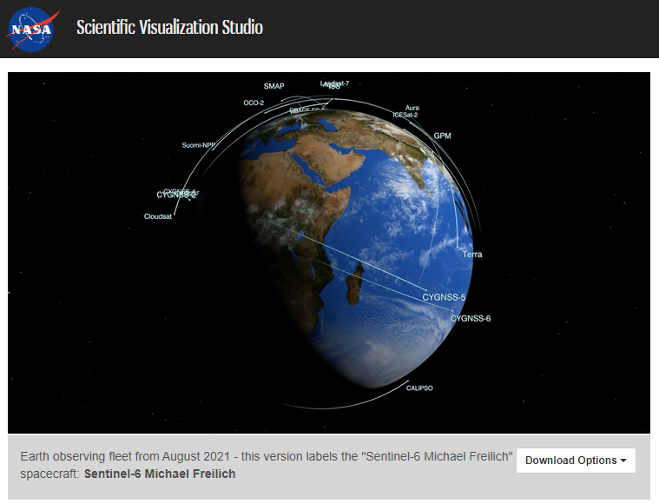
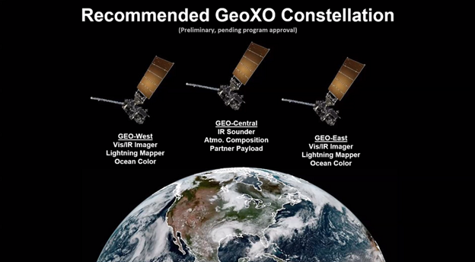
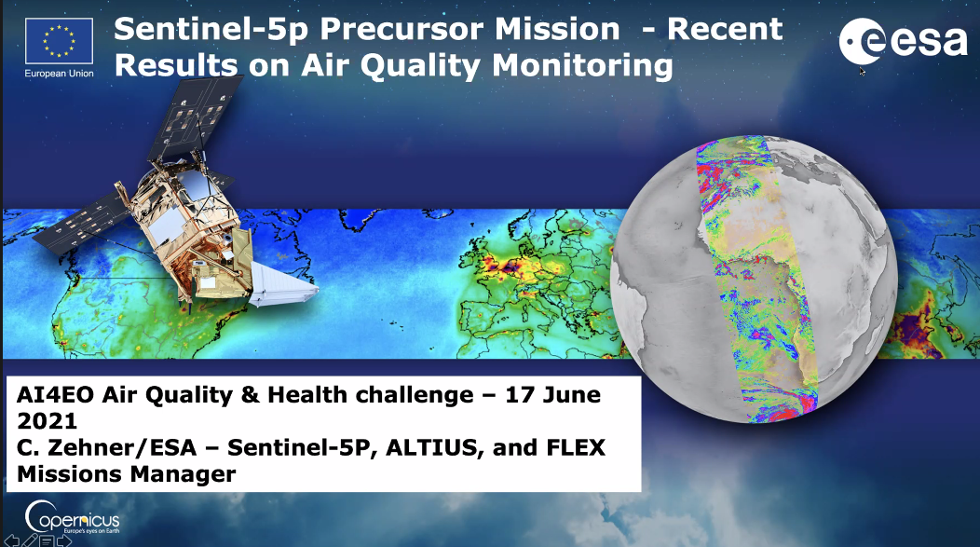
Several insights from public literature have contributed evidence to each of these areas:
EO has been used in global platforms for forest monitoring and as a data source for UN SDG 15 and Reducing Emissions from Deforestation and Forest Degradation (REDD+) reporting.
EO has been used to support forest governance, deter illegal logging, and conserve high-carbon forestry stocks.
EO has been applied as a cost-effective solution to optimise forest yield while also acting as an accountability tool for corporations to adhere to zero deforestation (ZD) commitments.
Numerous cases have demonstrated EO capabilities in detecting forest fires and improving emergency response.
Local forest populations have used EO to secure land rights and monitor and report illegal or harmful practices.
-3-
SV2
SV2

Slide 4
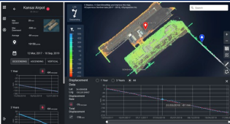
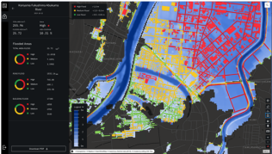
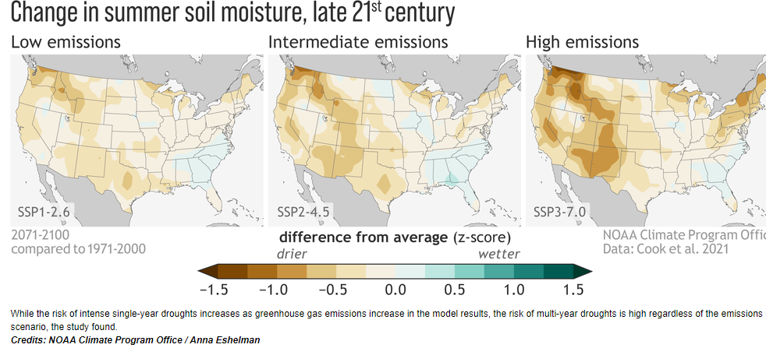
Practical application and results of remote sensing of the Earth.
The service "Synspectional monitoring of land shift" comes from the analysis of InSar * 2, which allows you to detect timely vertical displacement of the earth on a millimeter scale over a large area. This service allows you to periodically observe and understand the subsidence and deformation of the earth.
https://synspective.com/jp/news-press/land-displacement-monitoring/
The "Flood Damage Assessment Decision" assesses flood damage (flood area, depth of flooding, damaged roads, damaged buildings) as a measure in response to natural disasters. In the event of a disaster, especially when affecting large areas, early information and prompt action are important. SAR satellites are capable of observing any weather, on the ground, at any time of the day or night.
https://synspective.com/jp/news-press/synspective-announces-the-release-of-sar-based-flood?damage-assessment-solution-service
NISAR data can help people around the world better manage natural resources and hazards, as well as provide scientists with information to better understand the effects and pace of climate change and water management during droughts.
-4-
SV2
https://www.nasa.gov/feature/goddard/2021/nasa-durch-research-shows-value-of-both-climate-mitigation-and-adaptation
SV2

Slide 5
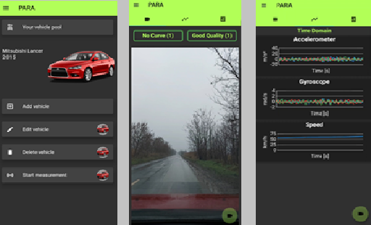
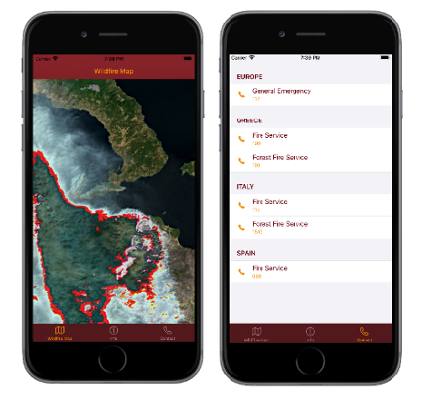
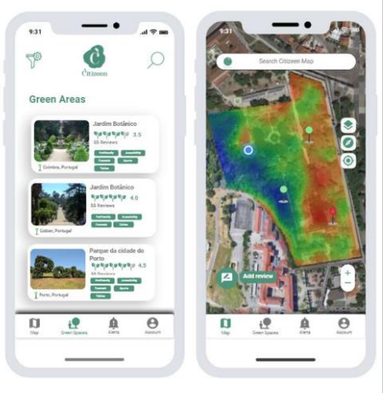
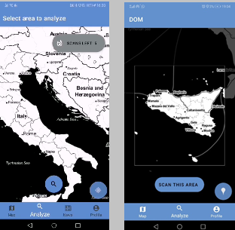
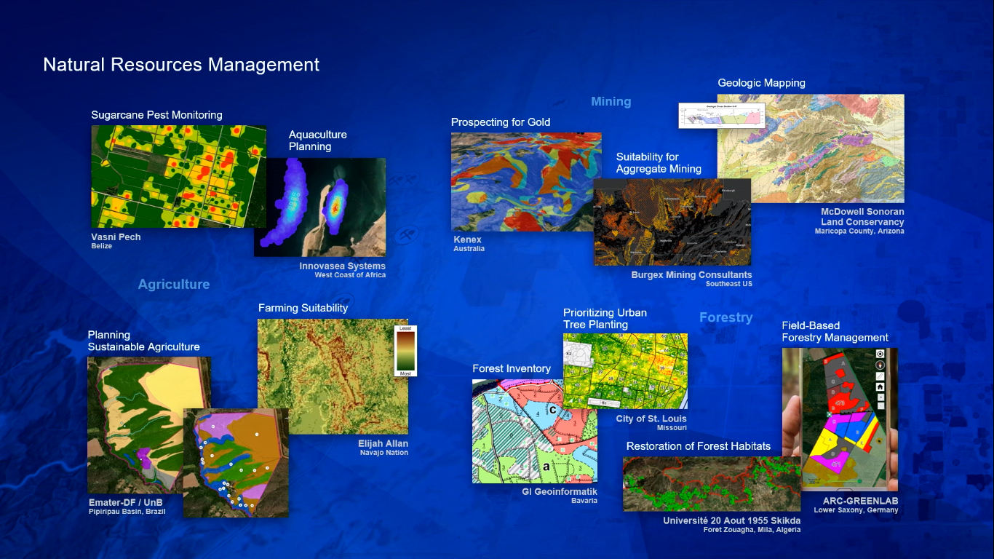
Applying these technologies to innovative ideas for mobile applications in a variety of areas: artificial intelligence, machine learning, Earth observation for smart cities, marine litter and coastal zone management, fire detection, transportation and natural resource management.
Pace Vector mobile application that uses satellite data to estimate the speed of trains, cars and trucks. The application has the potential to reduce road accidents and, for example, in decision-making on traffic management and maintenance.
The MyField mobile app allows farmers to prepare for the upcoming growing season by forecasting rainfall with information from Copernicus Sentinel-3.
The PARA mobile application determines the quality of roads using local measurements and satellite images, for example, to improve route planning for transport services.
The Float mobile app offers solutions to see, track and report high concentrations of floating plastic waste around coastal areas for cleaning.
-5-
https://www.esa.int/Applications/Observing_the_Earth/Copernicus/Wildfire_Map_wins_top_prize_at_App_Camp
SV2
SV2

Slide 6
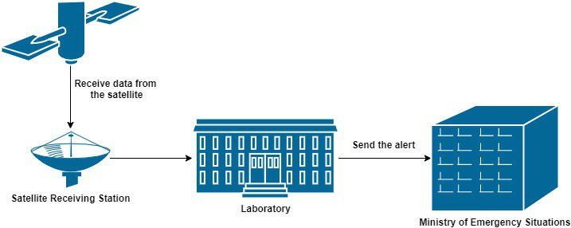
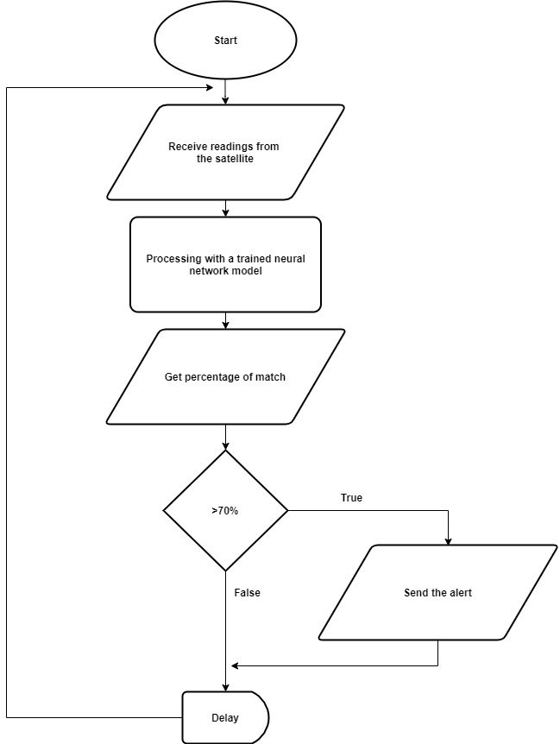
Based on the conducted analytical data, we fragment a universal set of machine learning tools for accurate, efficient and interpreted end-to-end data analysis with a combination of 5G technologies. It implements various machine learning and data analysis pipelines, including data preprocessing techniques and, more importantly, a variety of modern algorithms for multivariate time series analysis, classification, regression and structured output prediction capable of processing highly productive heterogeneous data. These methods allow you to create reliable and accurate forecasting models, which in turn are applied to various tasks of monitoring and planning operations.
https://www.nasa.gov/feature/goddard/2021/nasa-drought-research-shows-value-of-both-climate-mitigation-and-adaptation
https://spacenews.com/noaa-proposes-future-geostationary-constellation-with-east-west-and-center-satellites/
https://www-misr.jpl.nasa.gov/multimedia/
https://nisar.jpl.nasa.gov/
https://synspective.com/jp/news-press/synspective-announces-the-release-of-sar-based-flooddamage-assessment-solution-service/
https://synspective.com/jp/news-press/land-displacement-monitoring/
https://www.caribou.space/
https://live.letsgetdigital.com/2115-openday/virtualevent/#
https://www.esa.int/Applications/Observing_the_Earth/Copernicus/Wildfire_Map_wins_top_prize_at_App_Camp
-6-
SV2
SV2

Slide 7
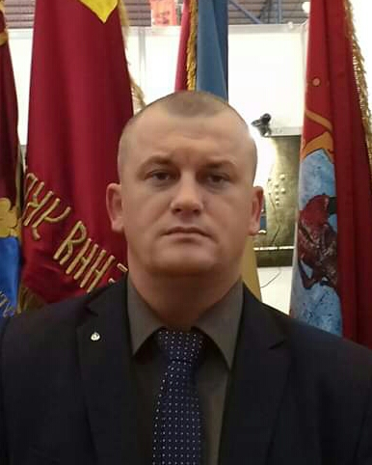


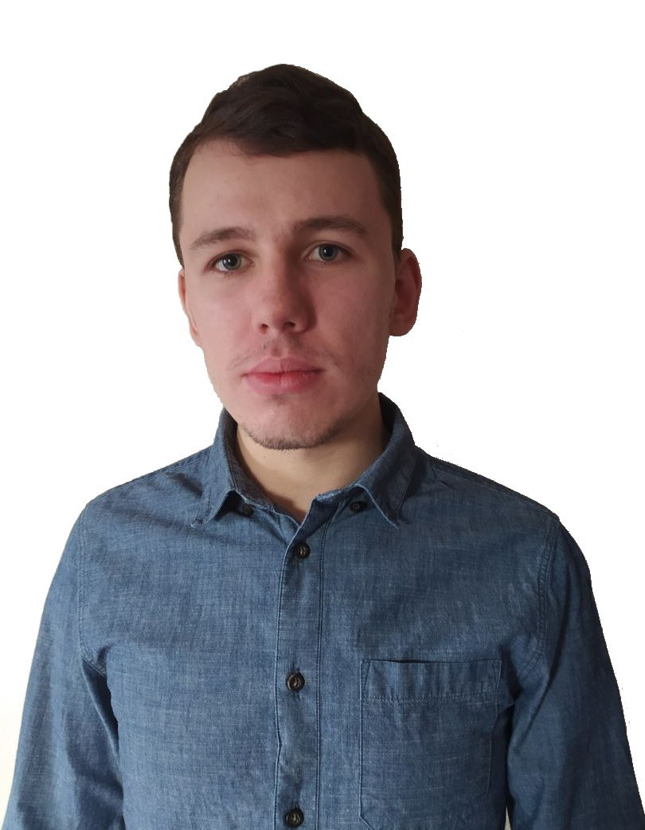

Stoliarchuk Vitalii Vasilievich Engineer mechanic. Postgraduate (PhD) of Oles Honchar Dnipropetrovsk National University. Testing engineer for rocket and space technology of State Design Office "Yuzhnoye" . Kvasha Oleg Alexandrovich Computer engineering. Second-year student of Dnipro University of Technology at the Faculty of Information Technologies.
Project executors
Thank you for your attention !!!
-7-
SV2
SV2

